Slide 1
Searching for a Hotel to stay
Capstone Project by IBM/Coursera

Slide 2
Problem
Often when a Student/Working Professional comes to a city for attending a seminar or any sort of thing, he/she searches for a hotel to stay and generally ends with lots of choices or no choice at all. This project is focused on easing the problem of finding a right place (Probable area in the city) to stay for an individual. We would prefer locations as close to the venue (Ex: College) as possible. Also we will keep in mind the different amenities around the hotel such as Shopping Mall, Cinema, Restaurant etc. while suggesting the area.
Target Audience: Anyone going to a new city and wants a Hotel to stay

Slide 3
Data Acquisition
Dataset used in this project will be taken from FourSquare.com API. The dataset will consists of hotels around the visiting venue along with their latitude and longitude details.
In our case, Venue name: Prestige Institute of Management and Research, Indore

Slide 4
Methodology and ML algorithms
We fetched the latitude and longitude of the visiting venue. Then, we will search for *Hotel* by providing the search query to the foursquare API call. within 500m radius.
We converted the data into dataframe and finally plot the hotels and venue on Map using folium library. We got the rating of the hotels again the foursquare API call.
We explored the hotels one by one and fetch multiple venues around the hotel along with their categories and location details and combined the data into a single dataframe.
In the last step, we applied K Means clustering algorithm to make clusters and finally display them on map and further analyze the results.

Slide 5
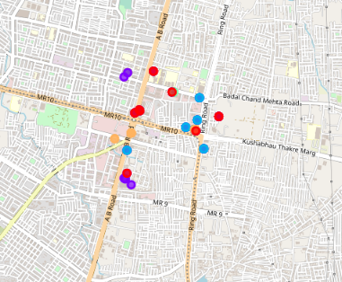

Slide 6
Results and Conclusion
After analyzing all the clusters, We found that in our case cluster 1 contains most probable hotels, one can consider to stay near the chosen venue.*
This is due to the fact in cluster 1, hotels also have multiple different venues around it such as Multiplex, Clothing Store, Bakery etc, whereas in other clusters they are absent or less in numbers.
Final decision on optimal hotel location will be made by the individual based on specific characteristics of hotels and locations around it.

Slide 7
Thank you!!

